Slide 1


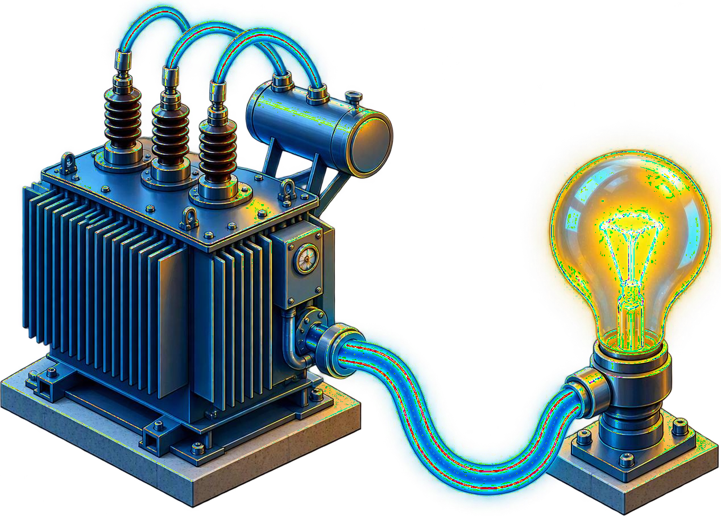
GENOVAATECH
LABS
PROJECT TITLE
Edge – AI Based Transformer Health Monitoring and Early Fault Prediction System
Embedded Systems • IoT • Embedded AI • Electrical and Electronics
Predictive Maintenance Using Edge Intelligence
MONITOR · DETECT · PREDICT
EDGE INTELLIGENCE FOR POWER ASSETS

Slide 2
GENOVAATECH
LABS
01
Problem Statement
TRANSFORMER / EDGE AI / PREDICTIVE MAINTENANCE
TEMPERATURE · VOLTAGE · CURRENT · VIBRATION
01 OPERATIONAL RISK
Transformers are critical components of electrical power systems, and unexpected failures can result in equipment damage, power interruptions, and increased maintenance costs. Conventional monitoring methods often rely on periodic inspections and individual parameter measurements, making it difficult to continuously identify early signs of abnormal operating conditions.
02 MONITORING GAP
There is a need for a compact, cost-effective, and intelligent monitoring system capable of continuously observing key transformer parameters such as temperature, voltage, current, and vibration, while identifying abnormal patterns at an early stage.
03 EDGE-AI RESPONSE
The proposed system addresses this challenge by combining multi-parameter sensing, embedded processing, and Edge-AI to enable real-time transformer health monitoring and early fault detection with reduced dependence on cloud-based processing.

Slide 3
GENOVAATECH
LABS
02
Abstract
TRANSFORMER / EDGE AI / PREDICTIVE MAINTENANCE
SENSE / PROCESS / PREDICT
01 SYSTEM CORE
This project presents an Edge-AI Based Transformer Health Monitoring and Early Fault Prediction System for real-time assessment of transformer operating conditions. An ESP32-S3 serves as the edge-processing platform and interfaces with sensors for monitoring temperature, voltage, current, and vibration.
02 LOCAL INTELLIGENCE
The acquired sensor data are processed locally through signal conditioning, feature extraction, and AI-based analysis to identify abnormal operating patterns and potential faults. By performing data processing and inference at the edge, the system reduces dependency on continuous cloud connectivity and enables faster response to critical changes.
03 SCALABLE PATH
The proposed solution provides a compact, low-cost, and scalable approach for intelligent transformer condition monitoring and predictive maintenance. The system can be further extended with additional parameters, larger fault datasets, remote dashboards, and advanced machine-learning models for improved fault classification and prediction.

